Slide 1
Wildlife and Zoos to see in Australia
By: Melissa Moreno

Slide 2
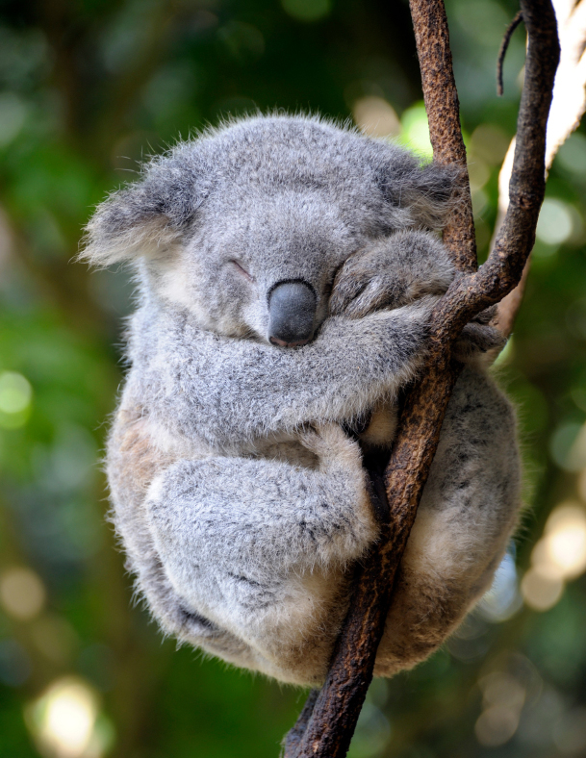
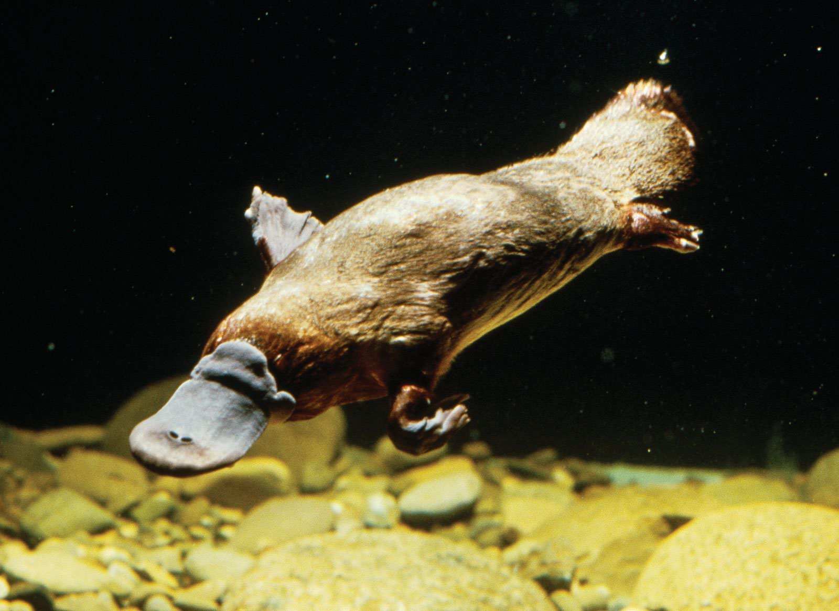
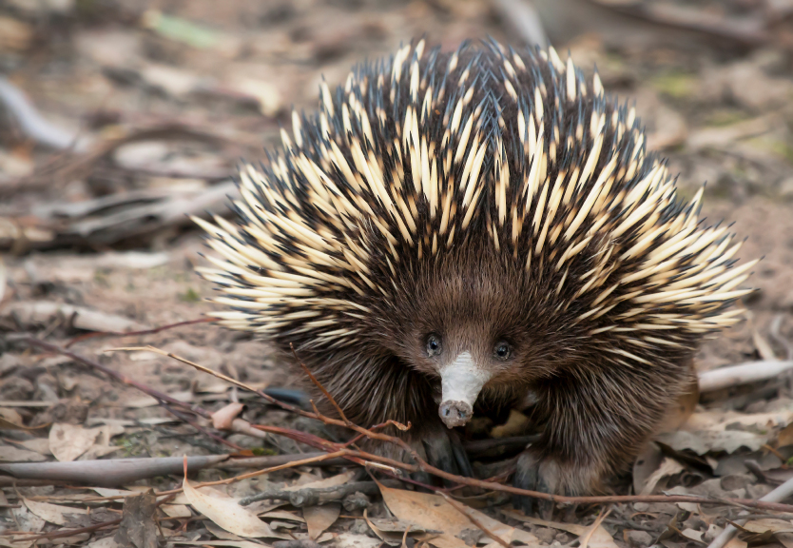
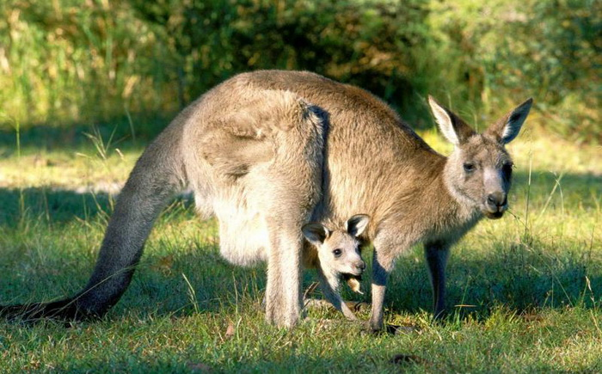
Endemic Animals to watch
Endemic- belonging exclusively or confined to a particular place

Slide 3
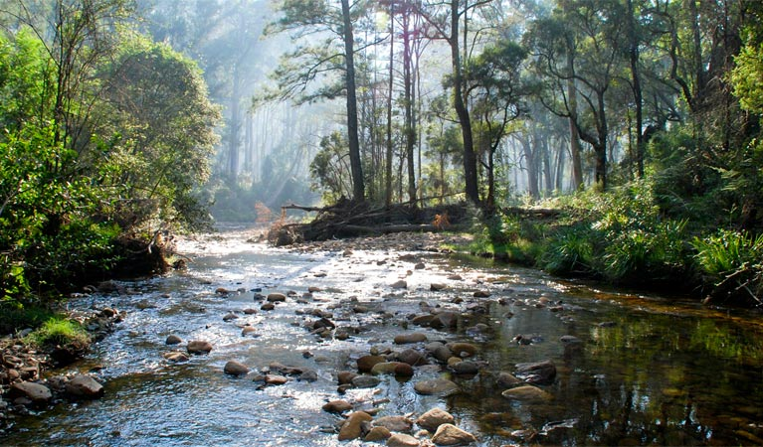
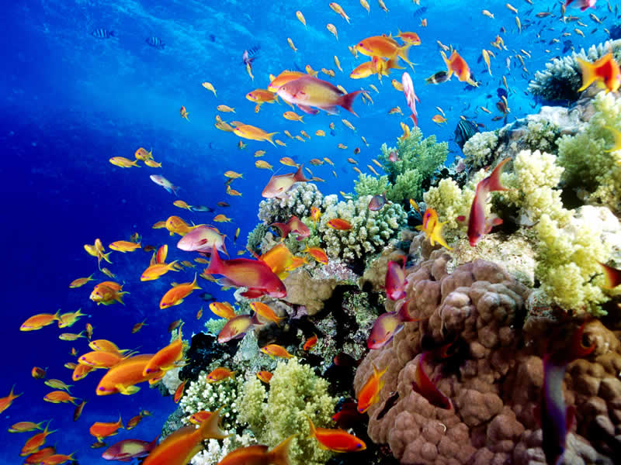
Conservation and tourists
Reasons to conserve
Australia very diverse animals and fauna
Most biologically diverse in the world
Important for future generations
Reefs
Animal habitats
Forests

Slide 4
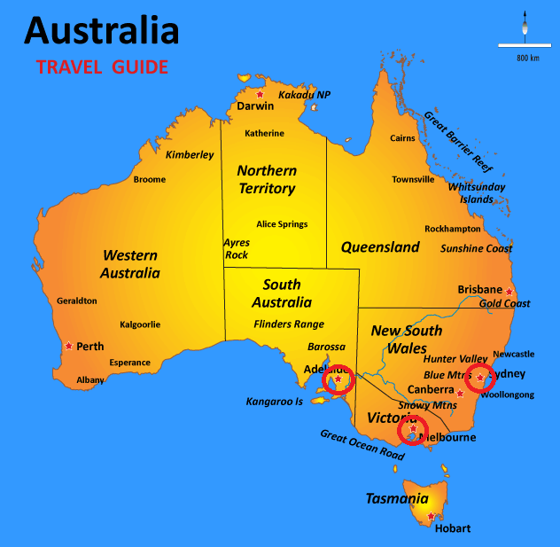
Conservation Zoos To visit
Taronga Zoo
Melbourne Zoo
Adelaide Zoo

Slide 5
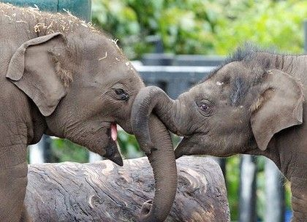
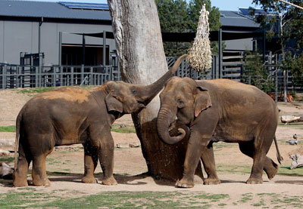
Taronga zoo
Located in Sydney, 1916
4,000 individual animals
Over 300 species
18 hectares
8 elephant herds
Rainforest trail
Seal Trail

Slide 6
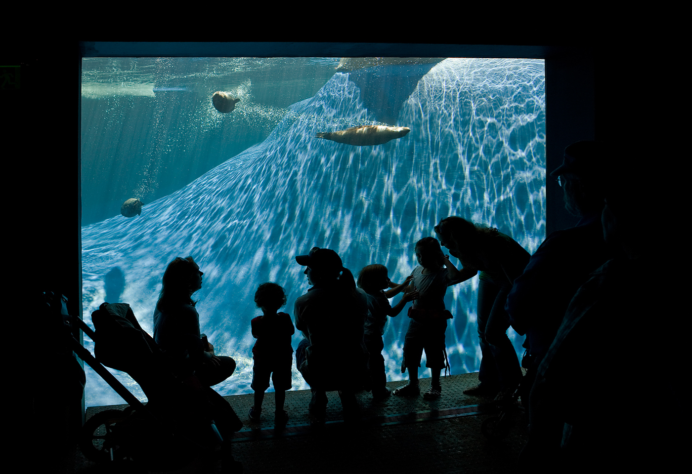
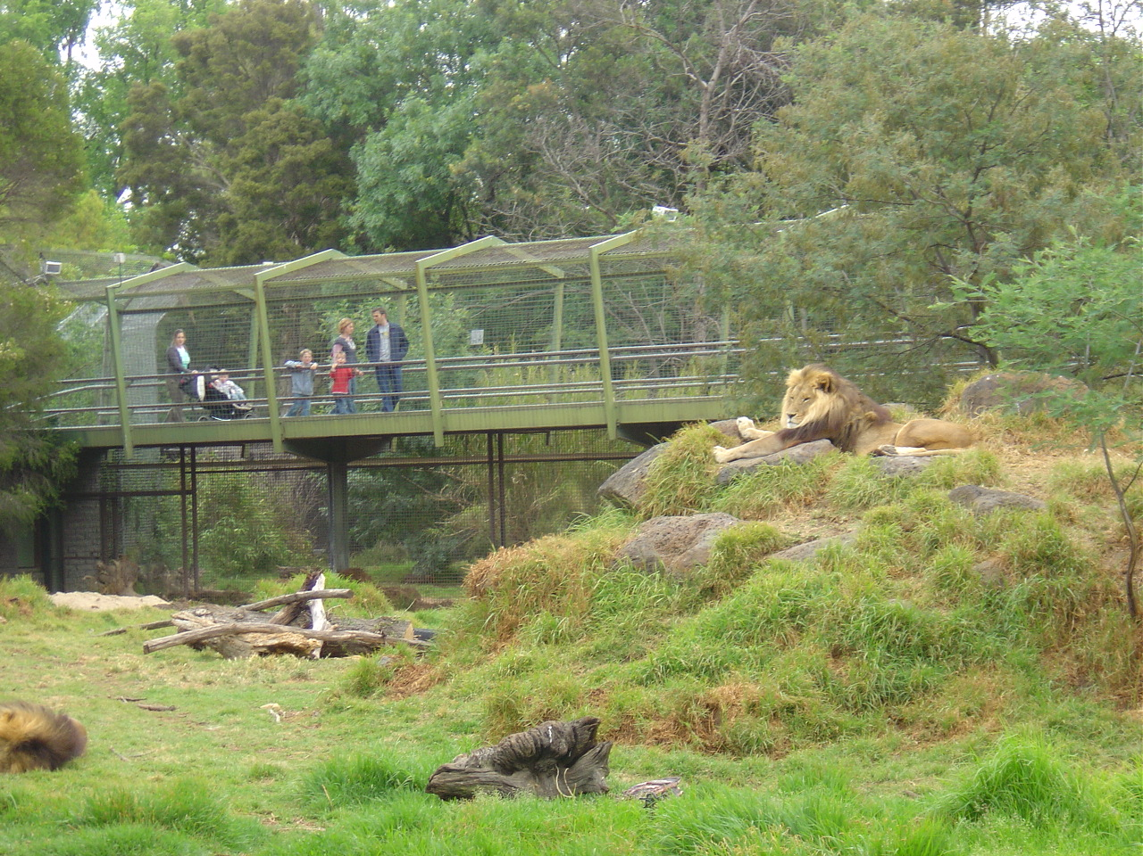
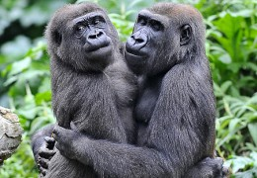
Melbourne zoo
Melbourne, 1862
Over 5000 individual animals
Over 300 species
22 hectares
Orangutan Sanctuary, 2 families
Wild Sea ($2 million)
African Rainforest (gorillas)
Lion Park

Slide 7
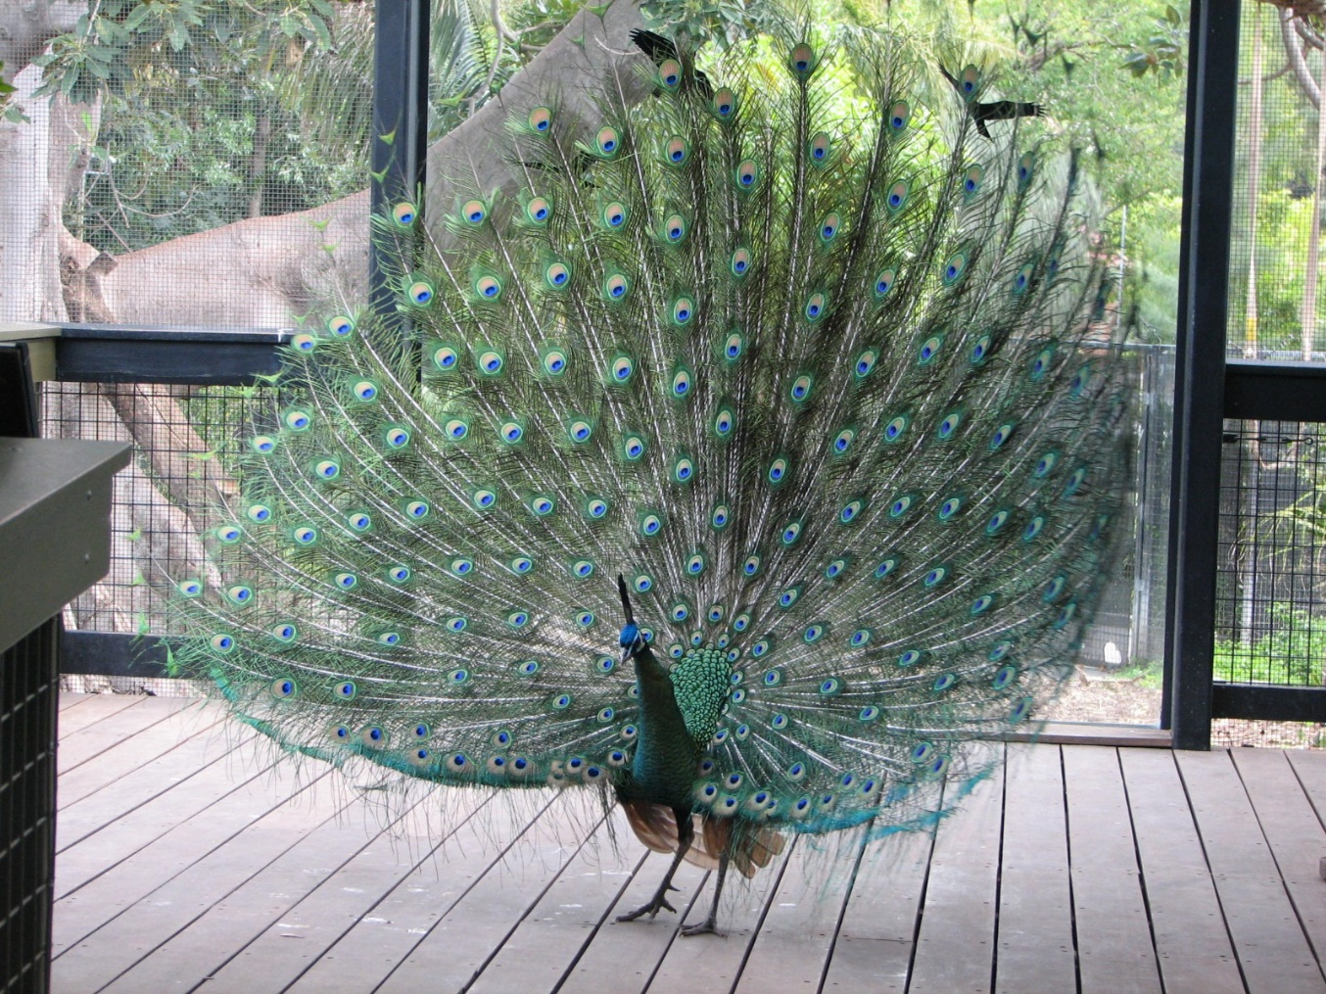
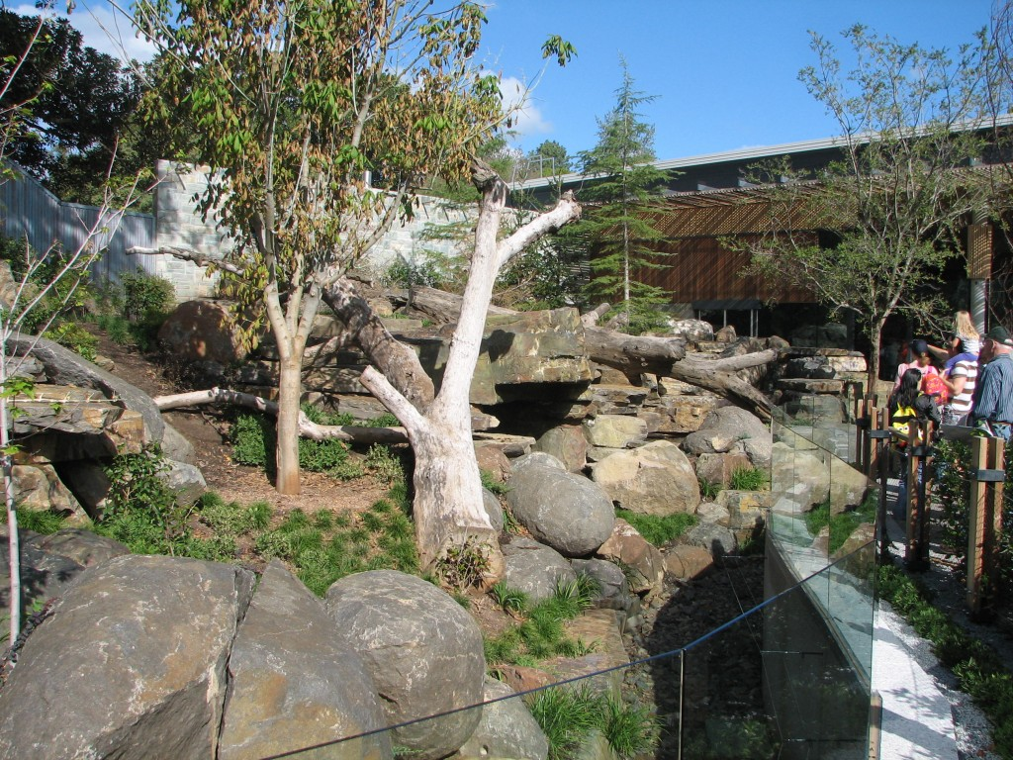
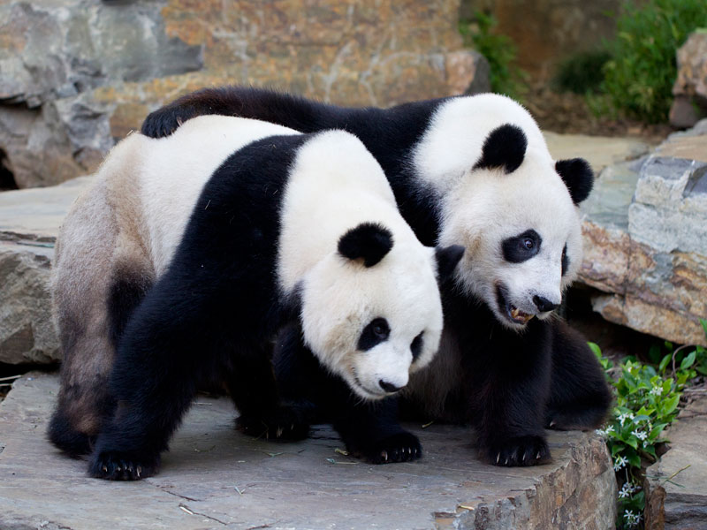
Adelaide zoo
Adelaide, 1883
Over 2000 species
Around 300 species
8 hectares
Giant Panda Exhibit
Southeast Asia Birds
Penguin Feed

